Slide 1
Medicines for Children
Practical and reliable advice for parents and
carers on giving medicines to their child
Project partners:

Slide 2
Medicines for Children – a partnership
Royal College of Paediatrics and Child Health
Neonatal and Paediatrics Pharmacy Group
Membership body for specialist paediatric pharmacists
WellChild
National children’s charity supporting families of children with complex health needs
Notes:
Medicines for Children is administered and funded by three organisations who have child health at their core.
The three organisations bring different perspectives and attributes to the project.
RCPCH – hosts the project in their London office and provides the support for the project staff. They also enable us to work with their members - paediatricians with specialist knowledge and experience
NPPG – a well-established member - organisation comprising neonatal and paediatric pharmacy professionals from across the UK with specialist knowledge on paediatric prescribing
The national children’s charity WellChild – bring the families perspective and provide the insight into what our users need next, guiding our decision making for future work

Slide 3
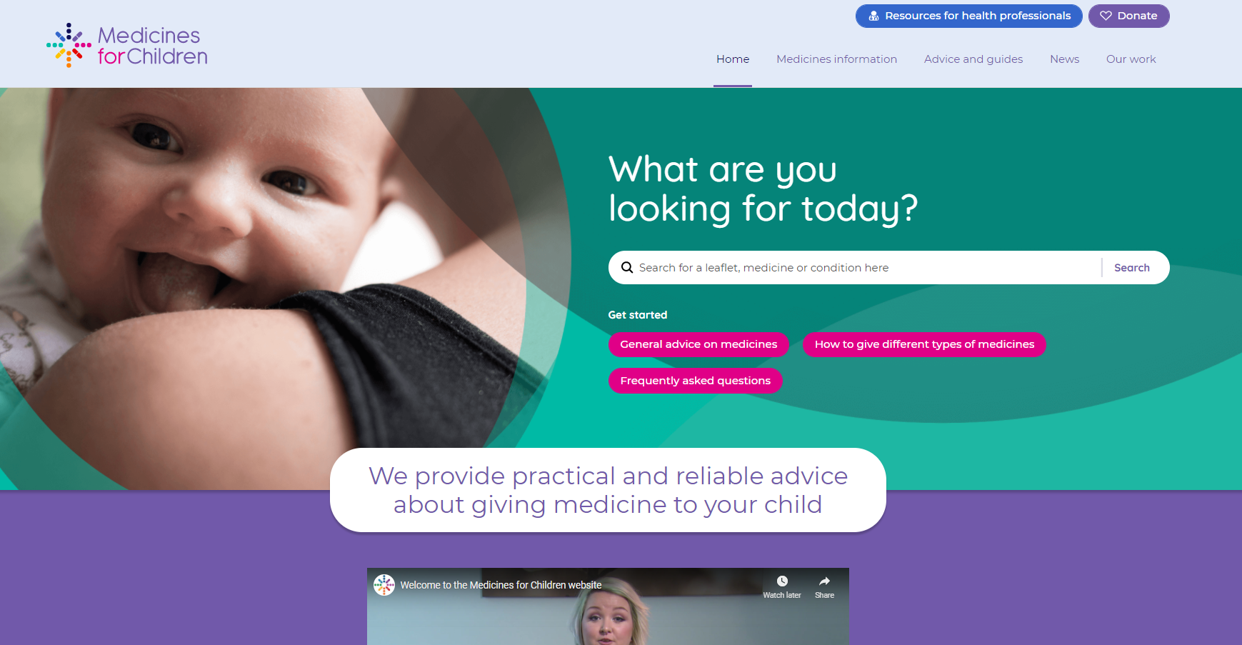
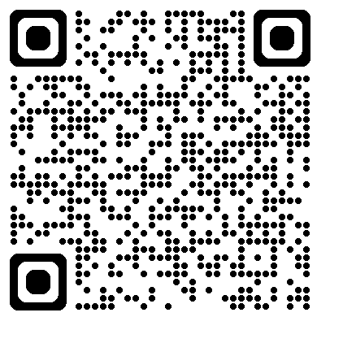
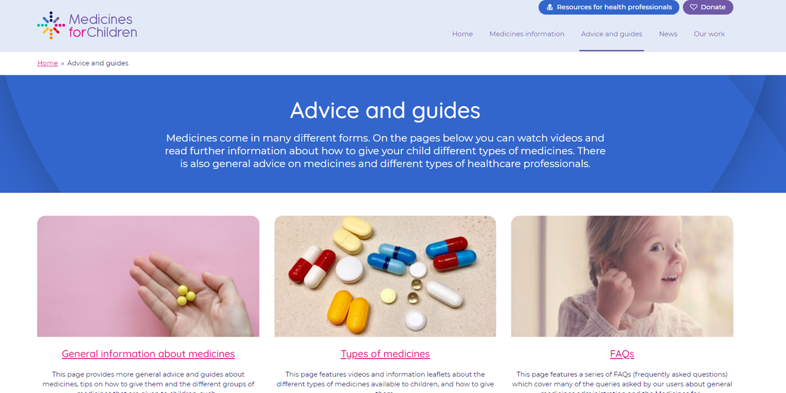
Medicines for Children website
An established and trusted information resource, founded in 2006 – website followed in 2009
Designed to support parents/carers giving medicines to their child in the home.
Over 220 medicines information leaflets, general guidance sheets and video guides.
Content developed by 100s of paediatricians and paediatric pharmacists over the last 18 years.
www.medicinesforchildren.org.uk
Notes:
The website launched in 2009
Designed to support parents/carers giving medicines to their child in the home.
Over 220 medicines information leaflets, general guidance sheets and video guides.
Content developed by 100s of paediatricians and pharmacists over the last 16 years.
Since launch the Medicines for Children website has recorded a total of:
22 million downloads of the medicines leaflets
16 million unique users visiting the site

Slide 4
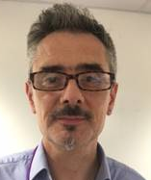
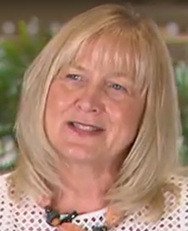
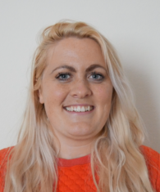
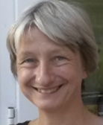
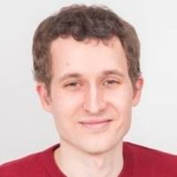
Meet the Medicines for Children project board
Who… are the people behind Medicines for Children?
MfC Project Chair Dr Andy Fox - NPPG Deputy Chief Pharmacist University Hospitals Southampton MfC Clinical Advisor Catrin Barker - NPPG Previous Chief Pharmacist Alder Hey Children’s hospital MfC Clinical Advisor Dr Yincent Tse - RCPCH Consultant Paediatrician Newcastle Hospitals NHS Trust MfC Clinical Advisor Stephen Tomlin - NPPG Associate Chief Pharmacist, Great Ormond Street Children’s hospital | MfC Clinical Advisor Dr David Tuthill - RCPCH Consultant Paediatrician Noah's Ark Children's Hospital Wales MfC Family Engagement Advisor Amy Mitchell - WellChild Director of Programmes WellChild, Cheltenham MfC Nurse Advisor Amika Challacombe - WellChild WellChild Clinical Nurse Specialist Sheffield Children’s Hospital MfC RCPCH Trainee Representative Dr Chris Parry - RCPCH Paediatric trainee Alder Hey Children’s hospital | MfC Digital Advisor Dr Graham Martin - RCPCH Paediatric trainee Medway Maritime Hospital MfC Medical Editor Dr Helen Barham Independent advisor (no affiliation RCPCH/NPPG/WellChild) MfC Primary Care Advisor Vacancy for a GP, community pharmacist or practice nurse
Notes:
The project board is made up of representatives from the three organisations behind Medicines for Children. They make decisions about the direction of the project and how it is governed. They decide on what work we should prioritise each year and also have the final say on any clinical changes that may be needed to the published medicines information.
We also have roles on the board for a GP, a nurse representative and a paediatric trainee to make sure that we are covering the needs of all of our users.

Slide 5
Medicines for Children – Where are our users from?
In the last 2 years, we have recorded over 3 million unique users.
Of our recent users the majority are from:
1. United Kingdom 44%
2. United States 20%
Medicines for Children has users visiting the website from every country in the world
There have been 16 millions users recorded in total since the website launched in 2009
3. India 13%
4. Philippines 5%
5. Australia 4%
6. Canada 3%
7. Pakistan 2%
8. South Africa 2%
9. Malaysia 2%
10. Nigeria 2%

Slide 6
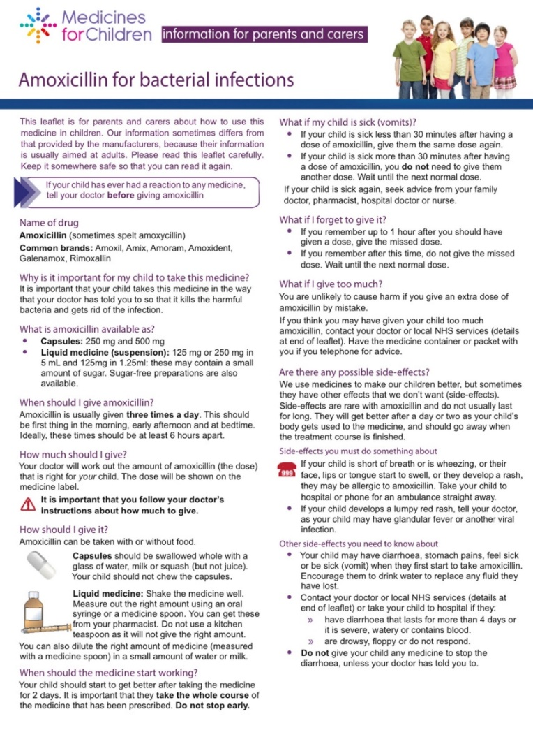
Example medicines leaflet PDF: Amoxicillin

Slide 7
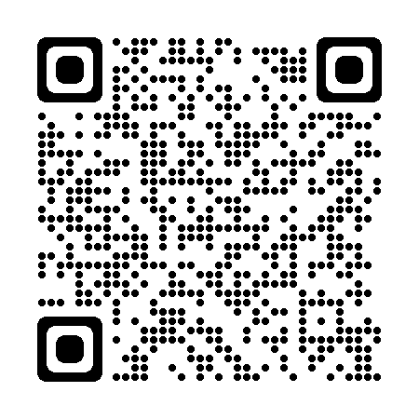
QR code posters for clinics/conditions
Full range of the Medicines for Children QR code posters available to view here:

Slide 8
Partnerships in 2025
Currently working with various groups/organisations to develop new medicines information:
Children’s Liver Disease Foundation
NPPG’s specialist interest groups (SIGs) - Cardiac SIG and Gastroenterology SIG
Alder Hey’s PADDINGToN study – to provide information for newborns leaving hospital with medicines
RCPCH E&T division - to produce information videos for families about different NHS staff roles
RCPCH’s Clean Air Fund - reducing the environmental impact from inhalers
Australian children’s hospitals and the New Zealand formulary
2025 highlights so far -
Awarded runner up for an HSJ award for “Best Provider of Digital Healthcare Services”

Slide 9
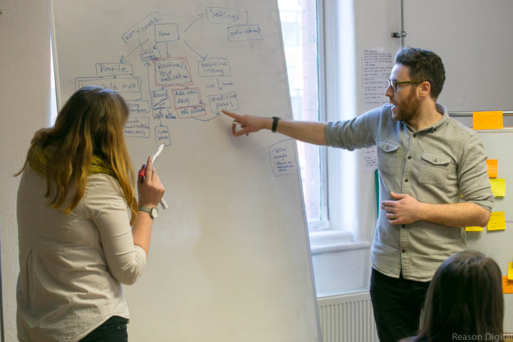
Why did we need an app?
“I am desperate for an app that will support my family. Could I be involved in supporting you with the development?” Parent user | “As a parent, and a Paediatric Nurse working in the community, I use the Meds for Children website with parents a great deal. Fantastic resource. Please make it an app too!” Paediatric Nurse
The app development has been funded entirely by external grants:
£48,000 from Comic Relief for Phase 1
(July 2018 – March 2019)
£106,000 from Fidelity for Phase 2
(October 2019 – now)

Slide 10
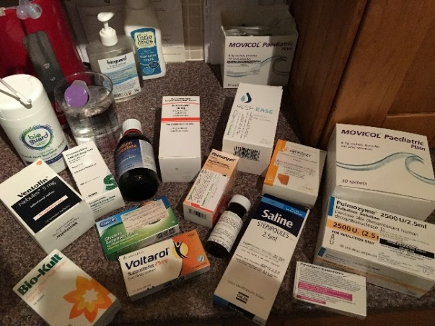
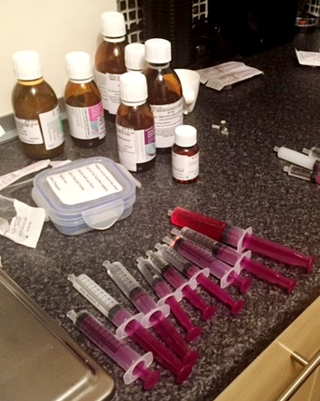
WellChild families’ role in developing the app
Families shared insights into their home care routines through surveys, videos, WhatsApp diaries and one to one interviews
Notes:
The insight from WellChild families has informed our work and shaped the direction of the app

Slide 11
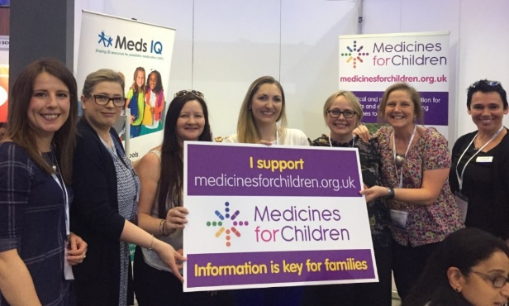
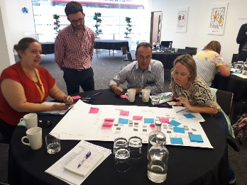
Parent and carer involvement
Parents from WellChild were instrumental in the app development to ensure we met our users' needs.
“My little girl has six different medications in the morning and seven in the evening. As a parent trying to learn the names, dosages and side effects of all these drugs is overwhelming.
Faith, WellChild parent
Survey of WellChild parents
Primary caregiver experiences of medication management in CYP with complex health needs
Survey was sent to ~2000 families via WellChild
220 responses returned (11% response rate)
Results from the survey
20% of respondents cared for more than one child with complex medical needs.
Most children (77%) had complex medical needs since birth and had required medications for more than 5 years (64%)
34% of children had been receiving regular medication for more than 10 years.

Slide 12
Key findings
Notes:
The insight from WellChild families has informed our work and shaped the direction of the app

Slide 13
Findings
Significant burden of care – time and emotion
Scheduling mechanisms exist; but they are vulnerable to external stressors
Perceived inadequate communication between caregivers and HCPs
Perceived lack of coherent care between HCPs themselves
Primary carer is burdened with keeping track of child’s full medicines history and their daily medicines schedule

Slide 14
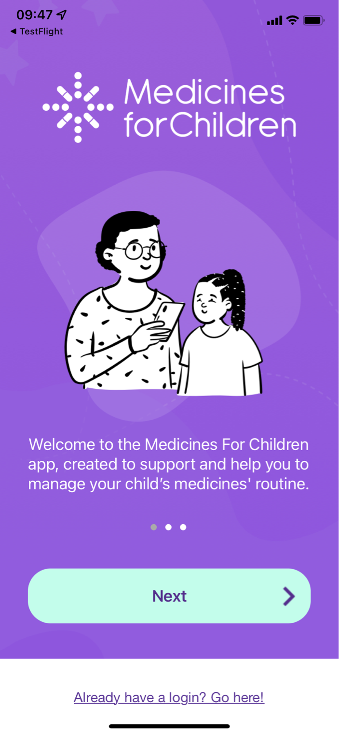
Solution?
An app to
empower families to
manage & communicate medication routines to reduce the risk of errors

Slide 15
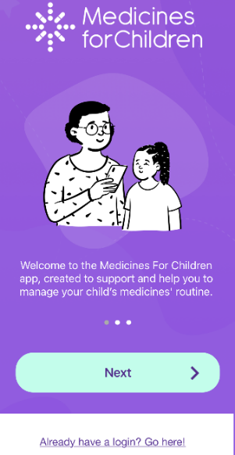
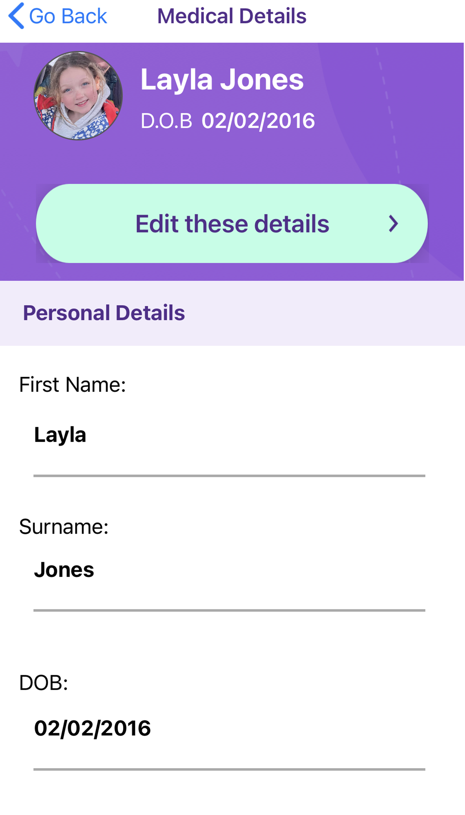
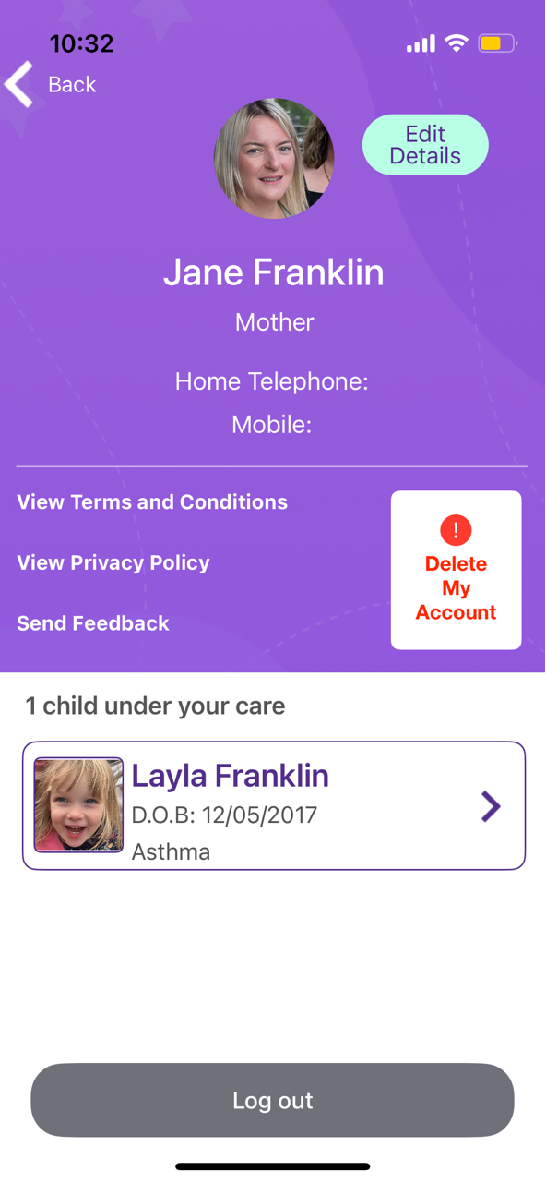
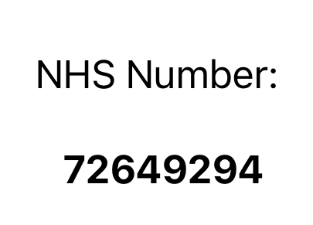
The medicines management app – setting up profiles
Setting up account to log on – using facial recognition | A section for the child’s medical profile | Parent/primary carer profile

Slide 16
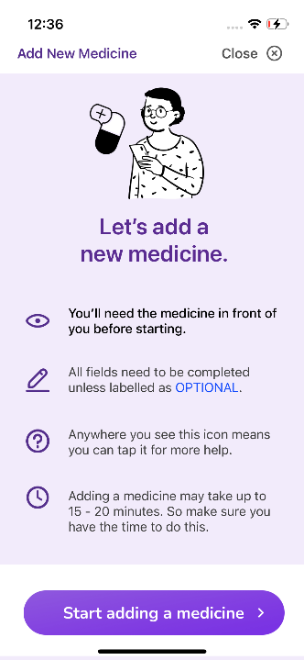
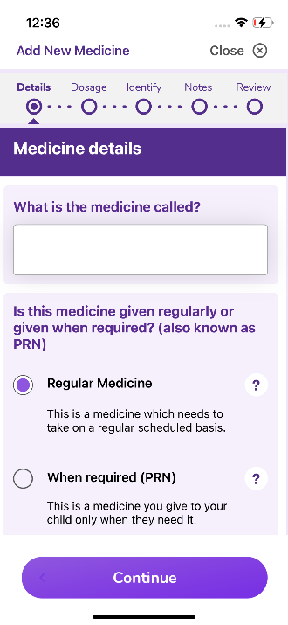
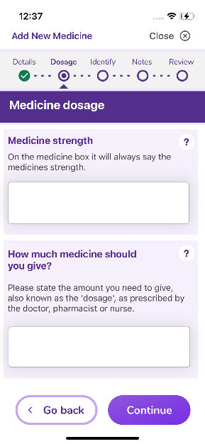
Ensuring accurate medicine information entry
Step by step support to help parents add a new medicine on to the app | Helpful text boxes to enter the key medicine’s information | Clear guidance to ensure medicine strength is correctly entered

Slide 17
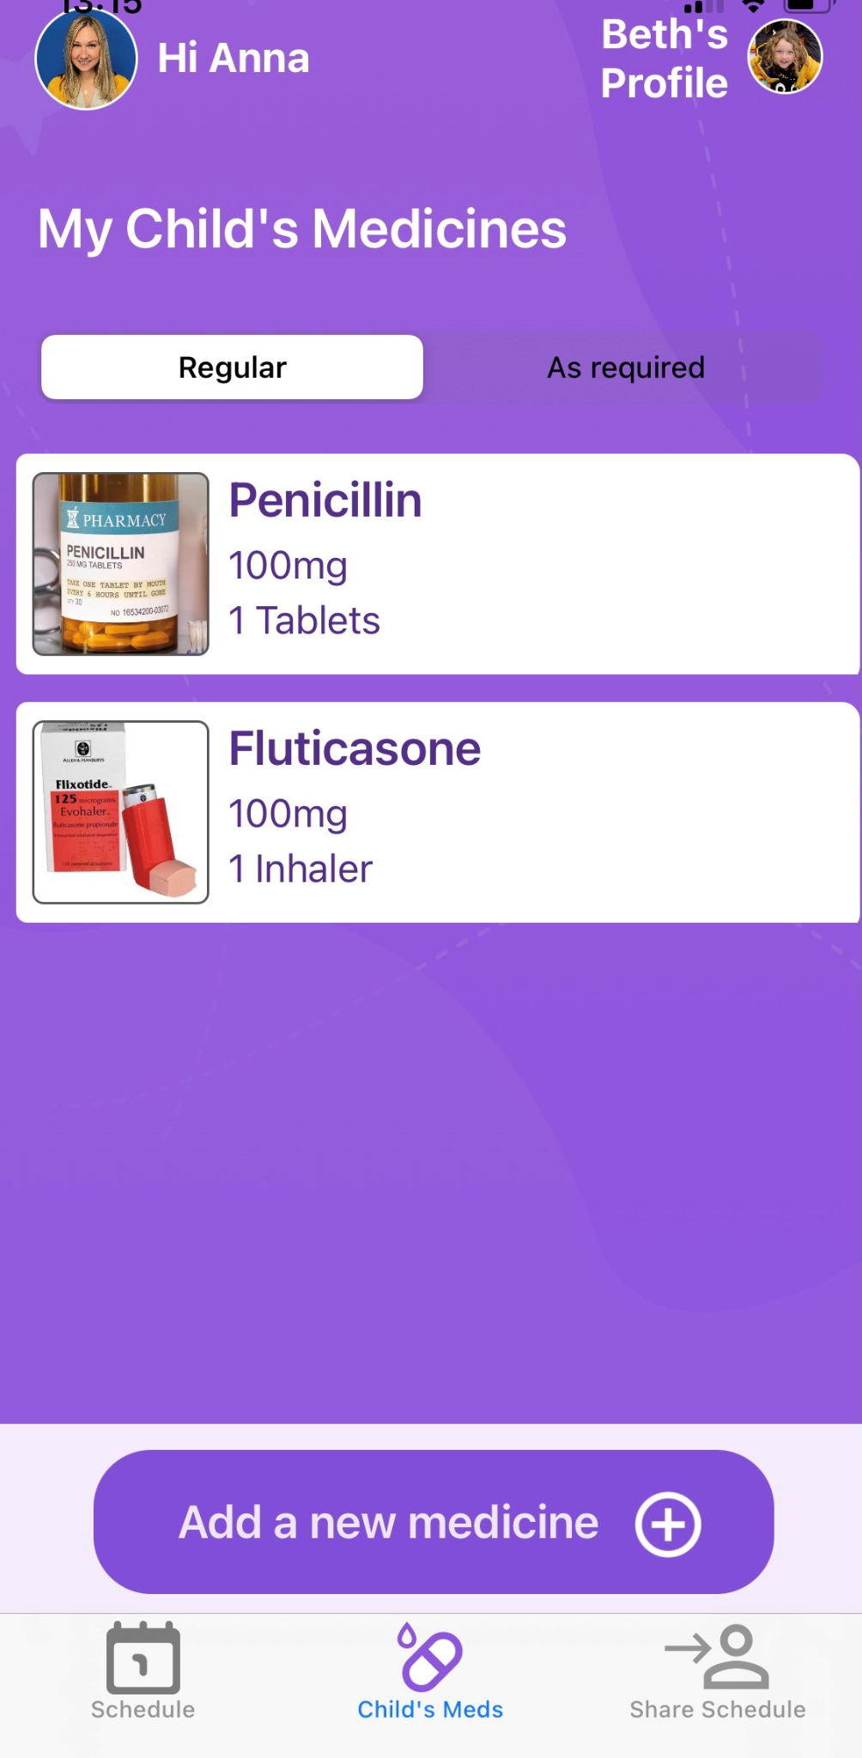
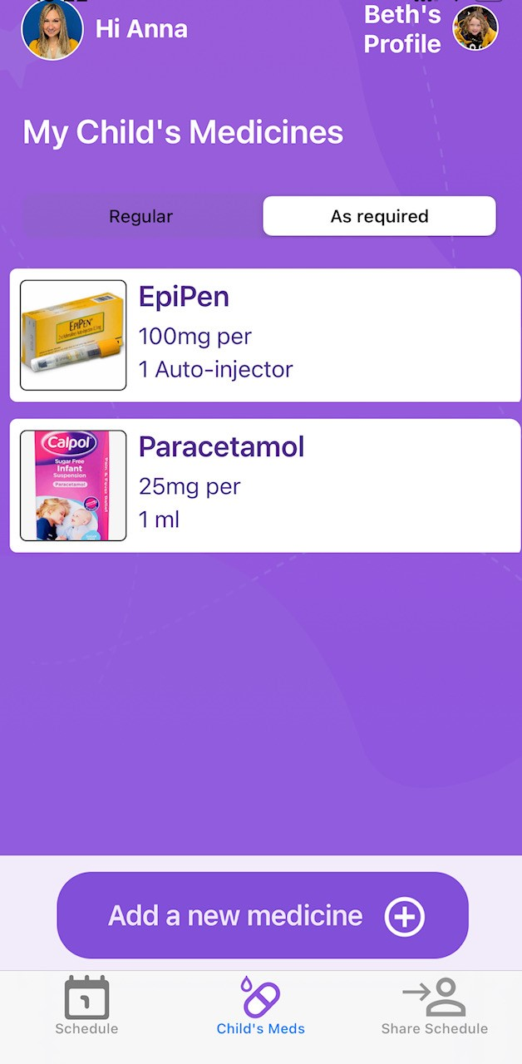
Medication list
Split into “Regular” and “As required” medicine
Take a picture of the exact box and label
Add a new medicine, including dosage and administration details

Slide 18
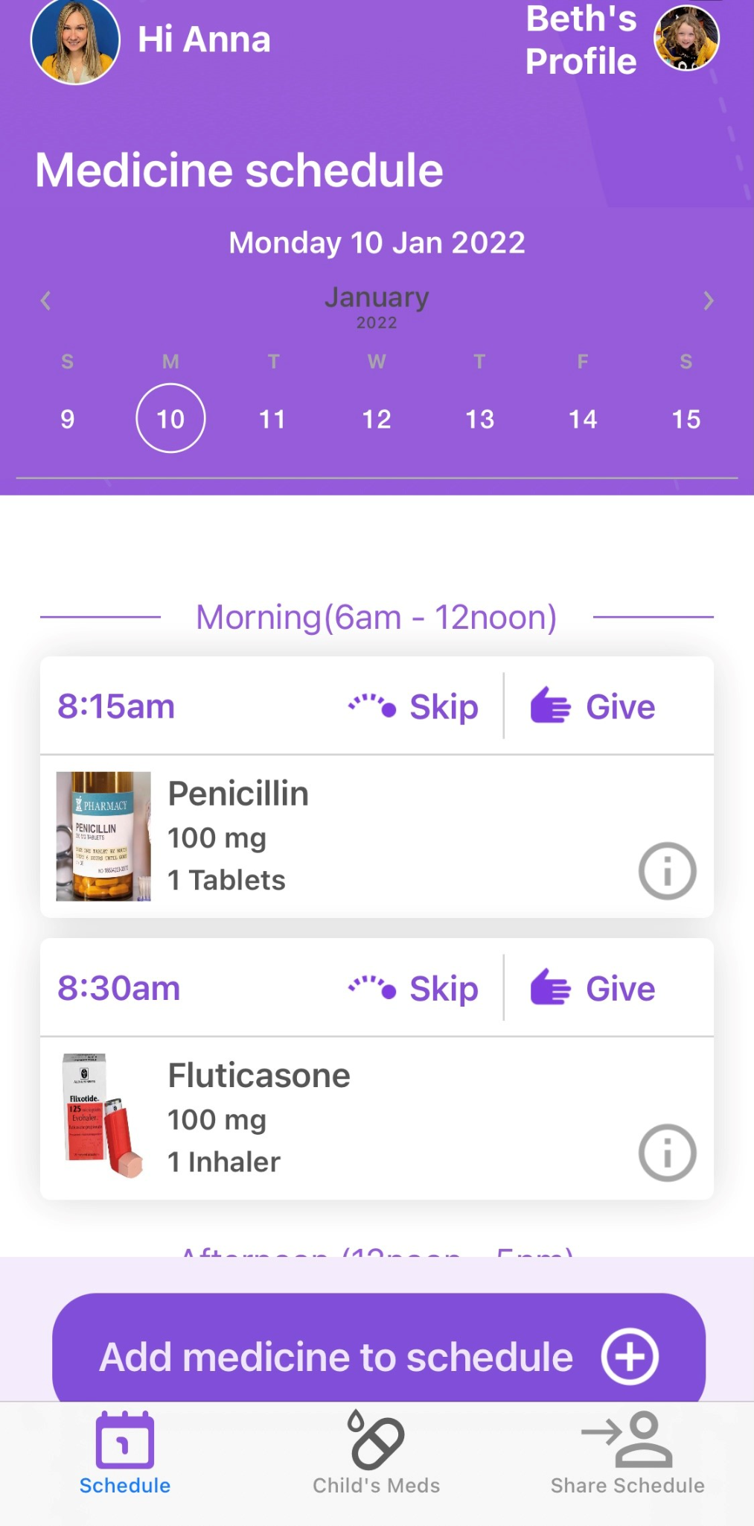
Calendar and daily medication schedule
Record when you’ve given or skipped the medicine
View the medication schedule for any given day
Overview of administration details for each medicine that day
Schedule a new medicine

Slide 19
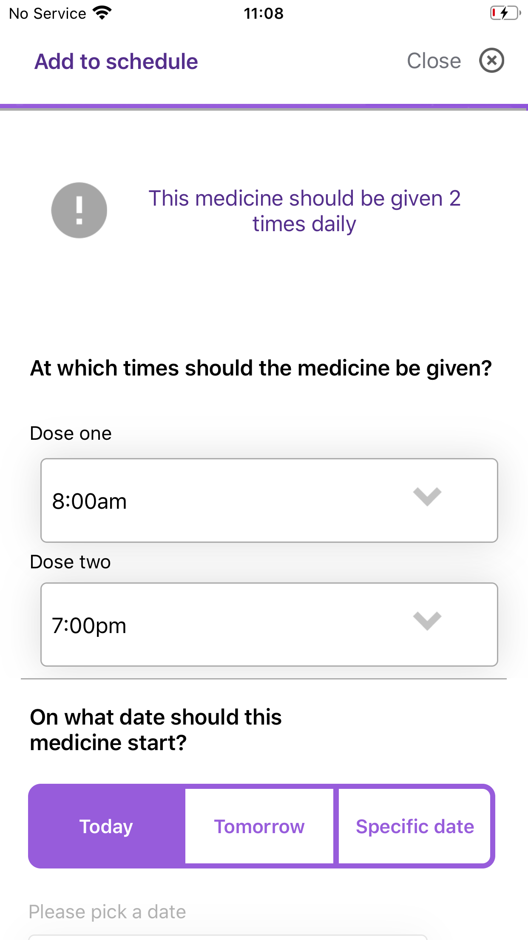
Scheduling a medicine
You can schedule regular medicines and enable reminders to give them.
Choose the exact time each dose should be given
Select when it should start and if/when it should end

Slide 20
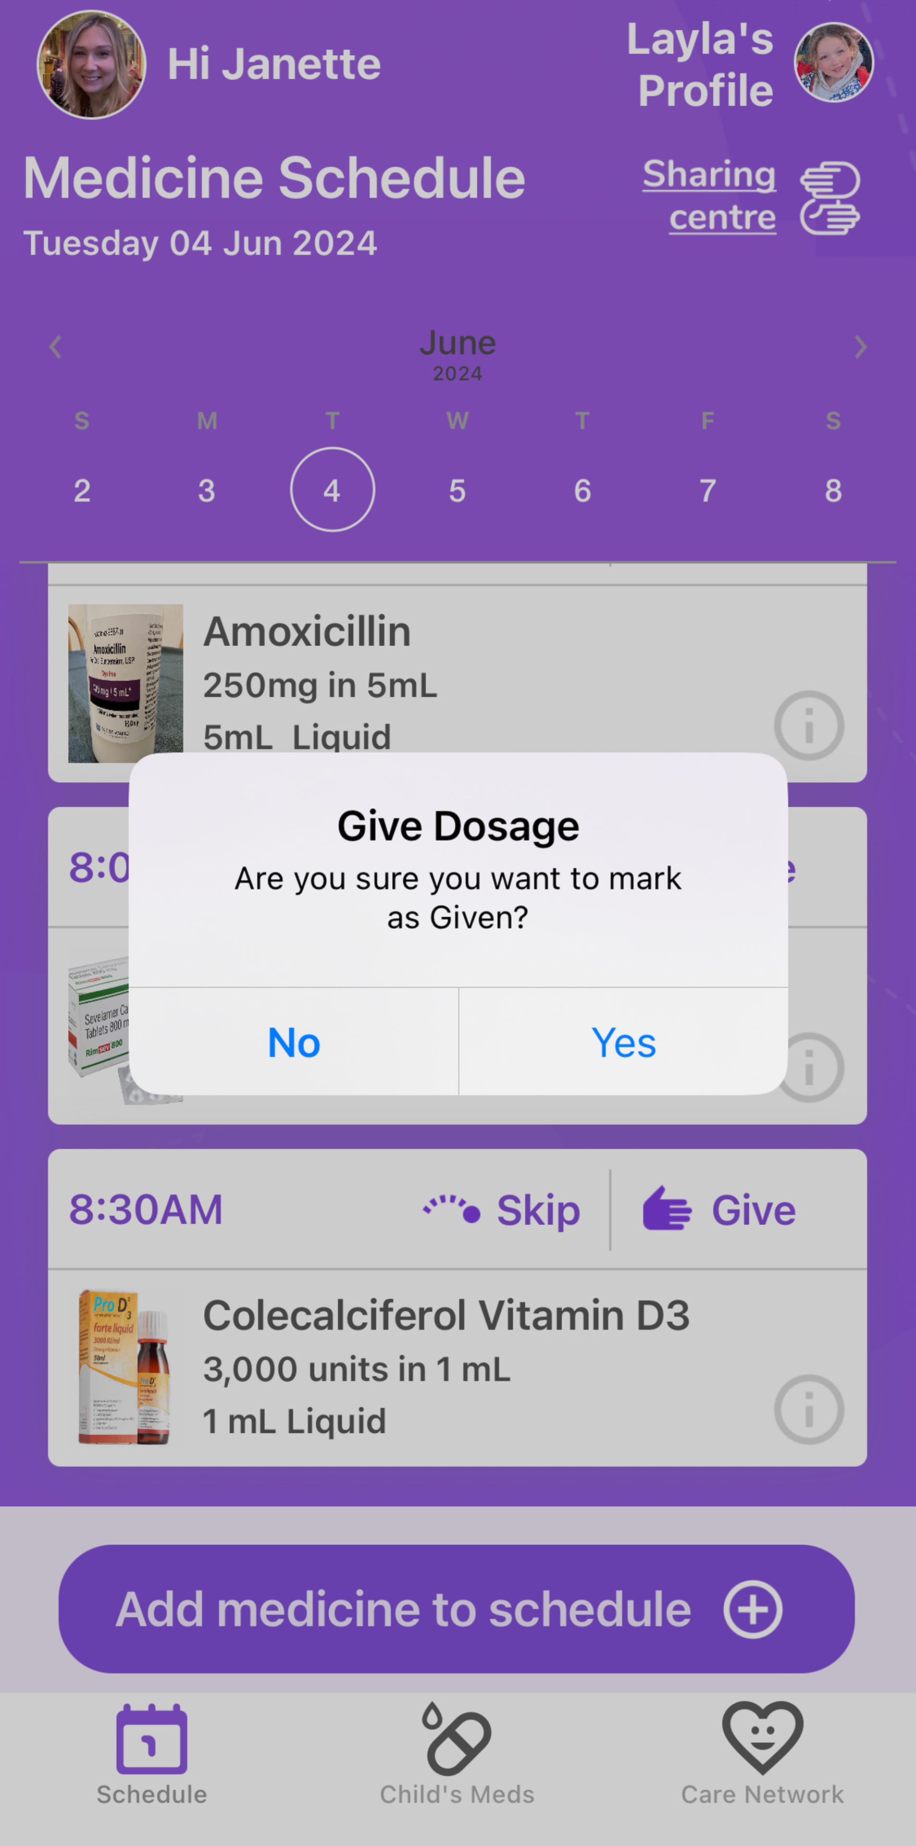
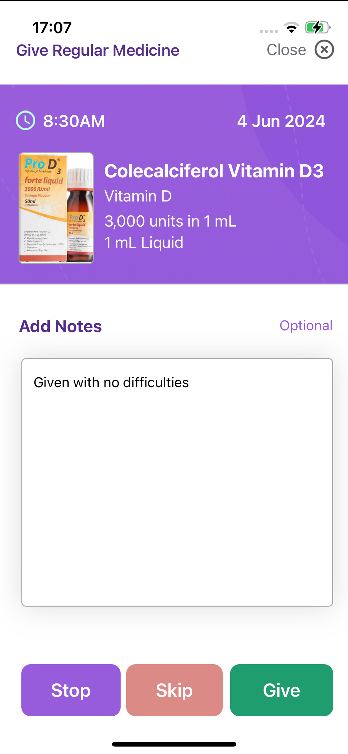
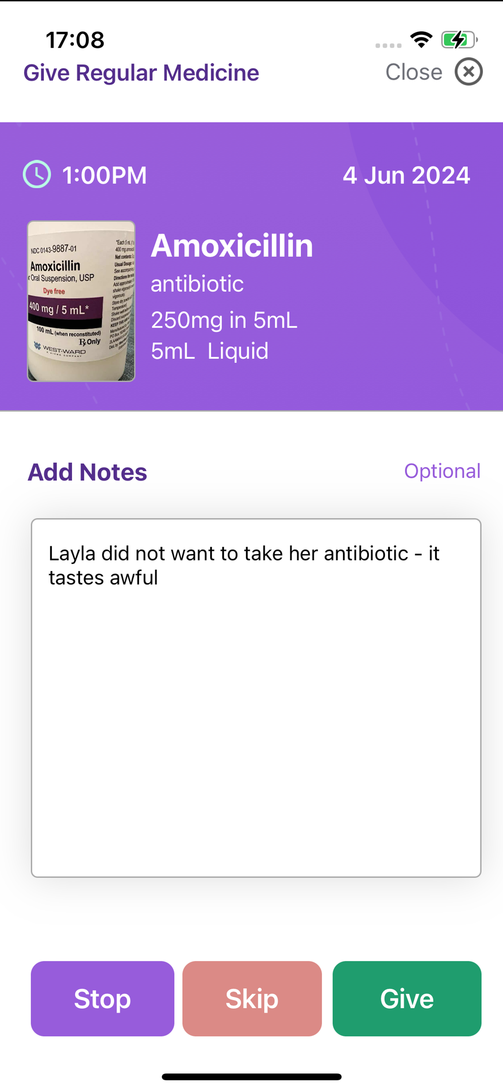
Scheduling medicines onto the daily calendar
Recording a medicine as ‘Given’ on the calendar | Adding a note about the medicine administration | Recording why a medicine was ‘Skipped’ – with notes

Slide 21
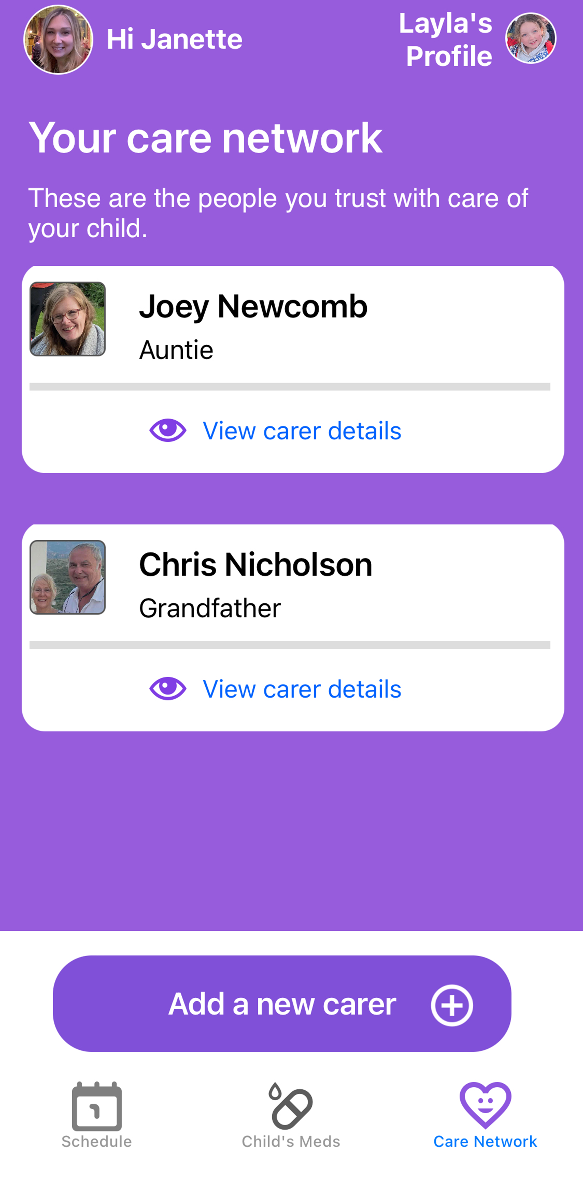
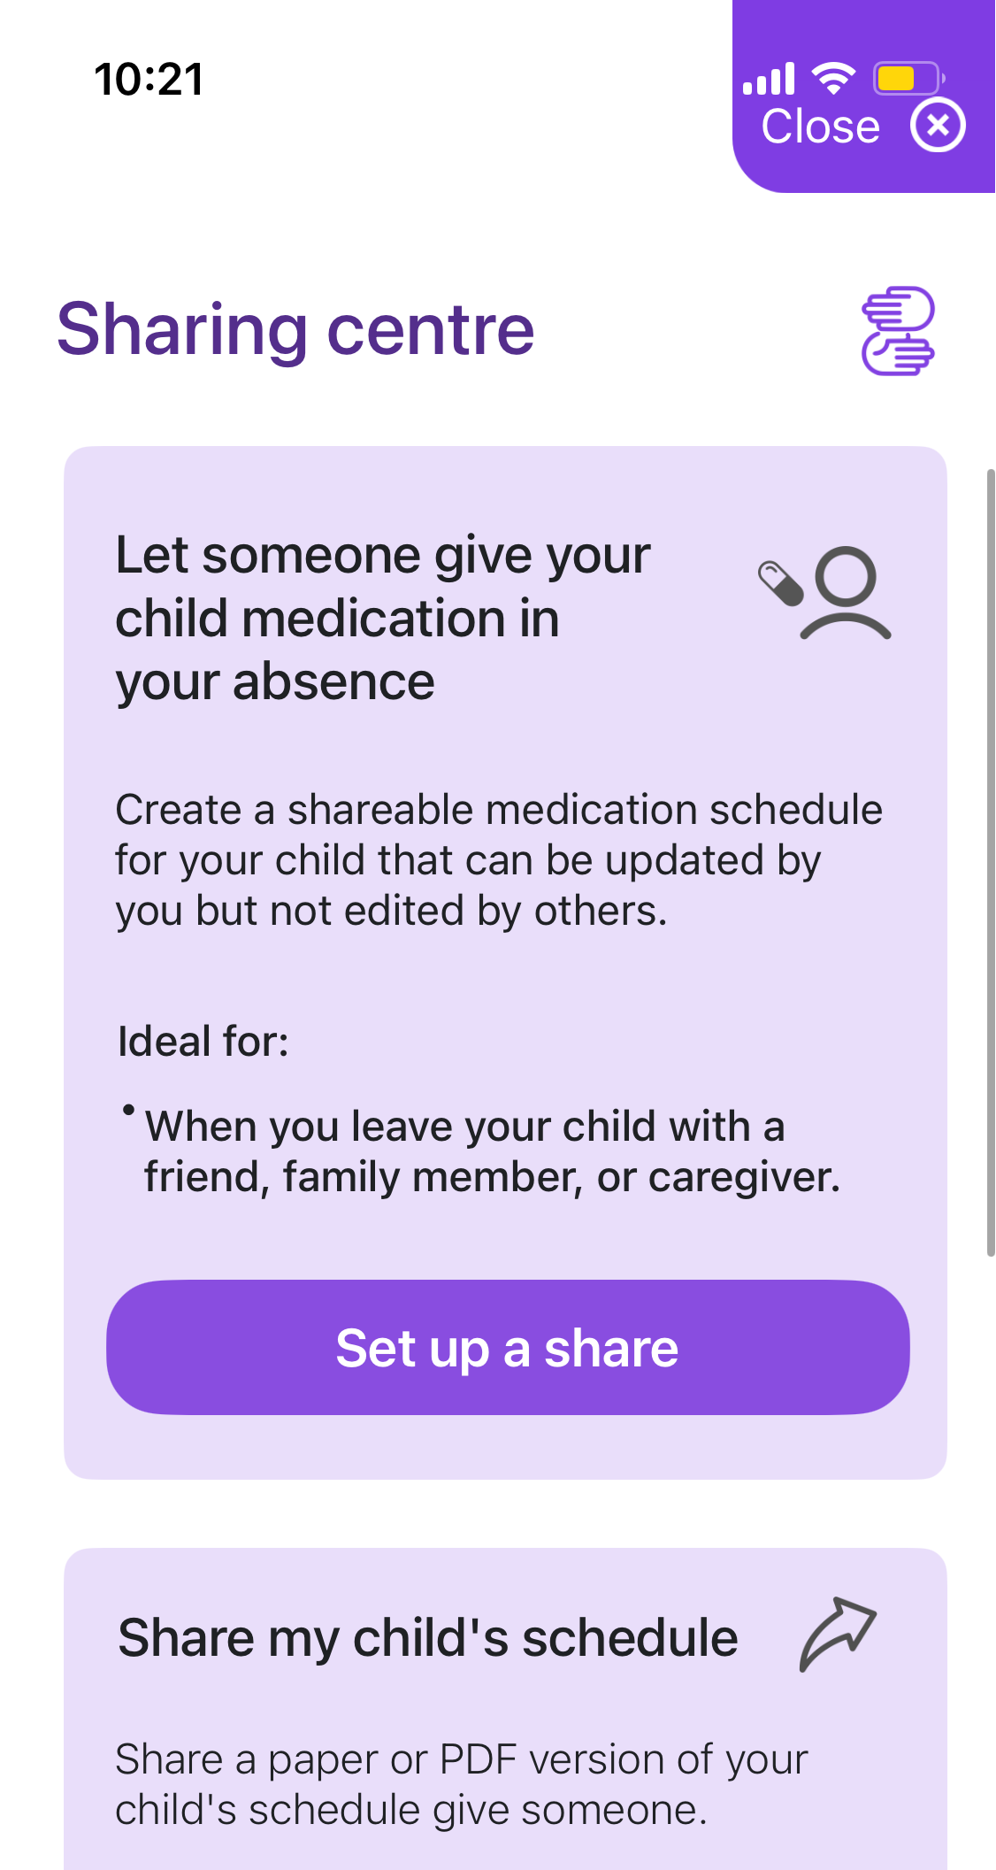
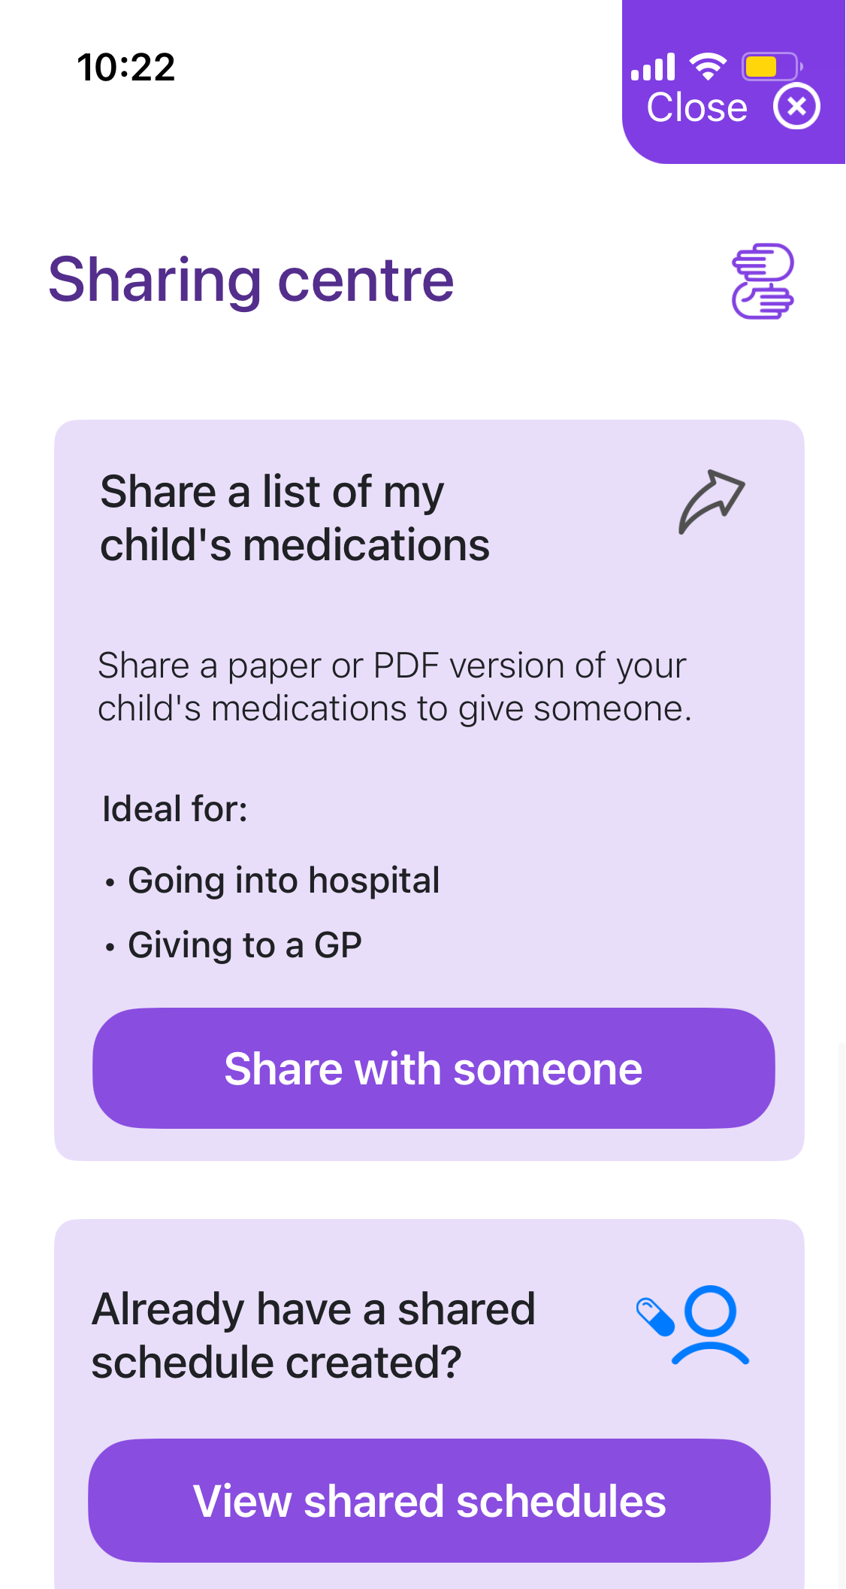
‘Shared care’ with other carers in a child’s network
Set up family/friends profiles for ‘shared care’ | Choose how to share the child’s medicines schedule – send a live link to or a paper/pdf version to print | Or download the child’s full medicines list to share with trusted carers/in healthcare settings

Slide 22
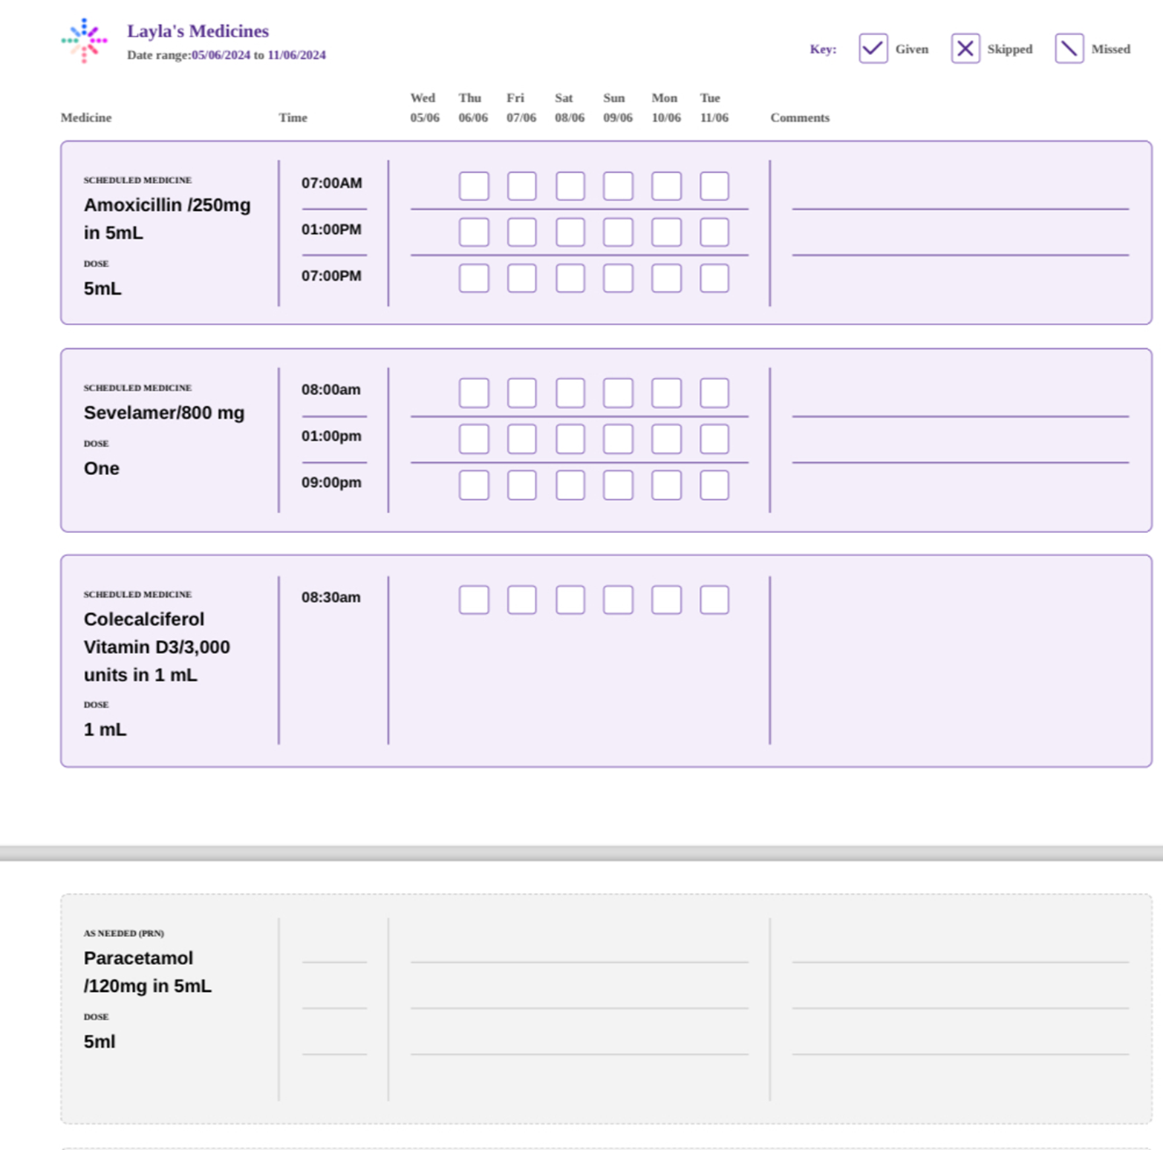
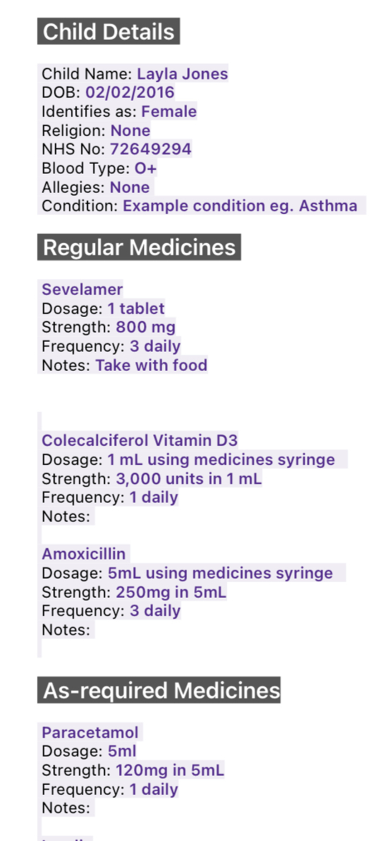
Using the daily meds info to create an accurate list & MAR (chart)
Meds info used to create a chart for respite carers to use - online or print version available | Full meds list to download and share with health professionals

Slide 23
Where is the app now?
User research (started in July 2018)
Prioritisation of new features
Design and develop app
Test it – with health professionals and parents/carers
Released on the app store! October 2024

Slide 24
Download the app here
Prioritisation of new features
Design and develop app

Slide 25
Next steps…
In talks with the children’s charity Dream Flight to adapt the app for their organisation’s use
Exploring funding opportunities to develop an Android version of the app (currently only available on Apple devices)
Identifying new features for the app that our users have requested for the next update
- The ability to have more than one child on the app
“I just wanted to let you know I have started using you app and find it really useful.
Would you consider developing it further so you could have more than one child on there? I am a GP myself and previously worked in A&E and found that often a lot of
mistakes were make when parents couldn’t remember which child had what medication when. I think this might be really useful”
London based GP

Slide 26
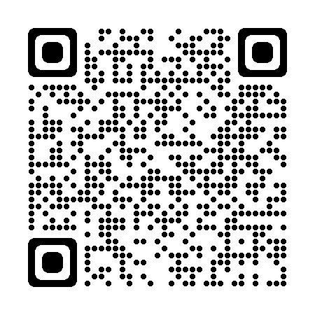
Medicines for Children home page
Practical and reliable information for parents and carers about how to give medicine to their child
Medicine leaflets and ‘how to’ videos available online, developed by paediatricians and pharmacists with consultation form parents, carers and young people.
Scan to access our full list of medicines leaflets
Scan to access our QR code posters

